Slide 1
Chapter 12 Information System Development

Slide 2
Chapter 12 Objectives
List the phases in the system development cycle
Describe the various tools used in object modeling
Identify the guidelines for system development
Explain the activities performed in the design phase
Discuss the importance of project management, feasibility assessment, documentation, and data and information gathering techniques
Recognize the develop programs activity is part of the system development cycle
Explain the activities performed in the planning phase
Discuss the activities performed in the implementation phase
Discuss the purpose of the activities performed in the analysis phase
Discuss the purpose of the activities performed in the operation, support, and security phase
Describe the various tools used in process modeling
Next

Slide 3
What is the System Development Cycle?
What is an information system (IS)?
Hardware, software, data, people, and procedures that work together to produce quality information
System—Set of components that interact to achieve common goal
Businesses use many types of systems
p. 620
Next

Slide 4
The System Development Life Cycle
What are the phases of the system development cycle?
Phase 2. Analysis
Phase 1. Planning
Conduct preliminary investigation
Perform detailed analysis activities:
Study current system
Determine user requirements
Recommend solution
Phase 3. Design
Review project requests
Prioritize project requests
Allocate resources
Form project development team
Acquire hardware and software, if necessary
Develop details of system
Phase 5. Operating, Support, and Security
Phase 4. Implementation
Develop programs, if necessary
Install and test new system
Train users
Convert to new system
Perform maintenance activities
Monitor system performance
Assess system security
p. 620 - 621 Fig. 12-1
Next

Slide 5
What is the System Development Cycle?
What are guidelines for system development?
Arrange tasks into phases (groups of activities)
Involve users (anyone for whom system is being built)
Develop clearly defined standards (procedures company expects employees to follow)
p. 621 - 622
Next

Slide 6
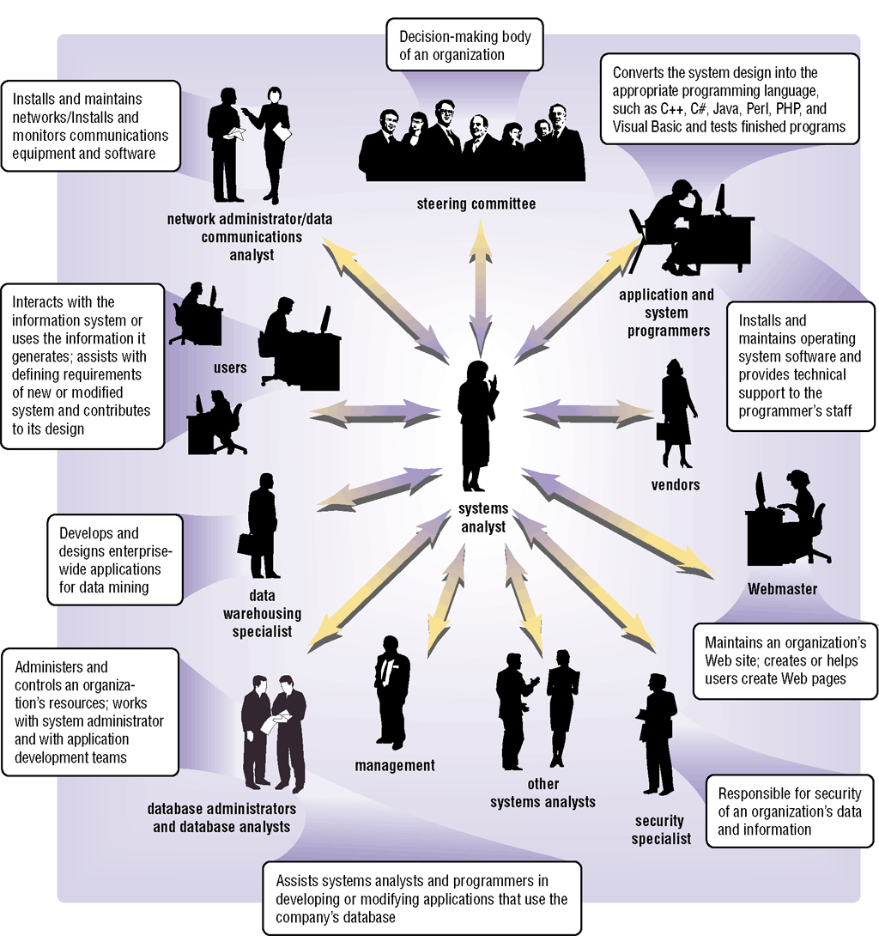
What is the System Development Cycle?
Who participates in the system development life cycle?
p. 622 Fig. 12-2
Next

Slide 7
What is the System Development Cycle?
What is a systems analyst?
Responsible for designing and developing information system
Liaison between users and IT professionals
p. 622 - 623
Next

Slide 8
What is the System Development Cycle?
What is the project team?
Formed to work on project from beginning to end
Consists of users, systems analyst, and other IT professionals
Project leader—one member of the team who manages and controls project budget and schedule
p. 623
Next

Slide 9
What is the System Development Cycle?
What is project management?
Process of planning, scheduling, and controlling activities during system development cycle
Project leader identifies elements for project
Goal, objectives, and expectations, collectively called scope
Required activities
Time estimates for each activity
Cost estimates for each activity
Order of activities
Activities that can take place at same time
p. 623
Next

Slide 10
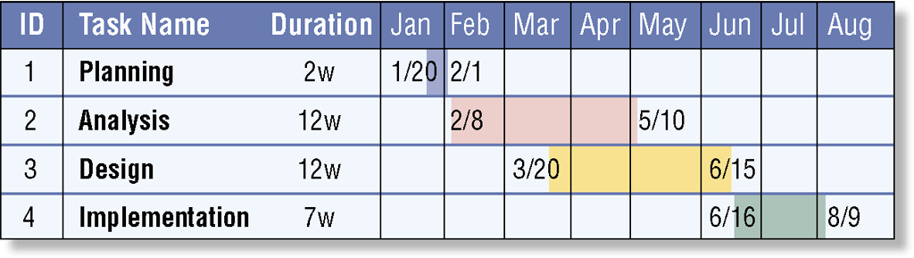
What is the System Development Cycle?
What is a Gantt chart?
Popular tool used to plan and schedule large, complex projects
Click to view Web Link, click Chapter 12, Click Web Link from left navigation, then click PERT Charts below Chapter 12
p. 623 - 624 Fig. 12-3
Next

Slide 11
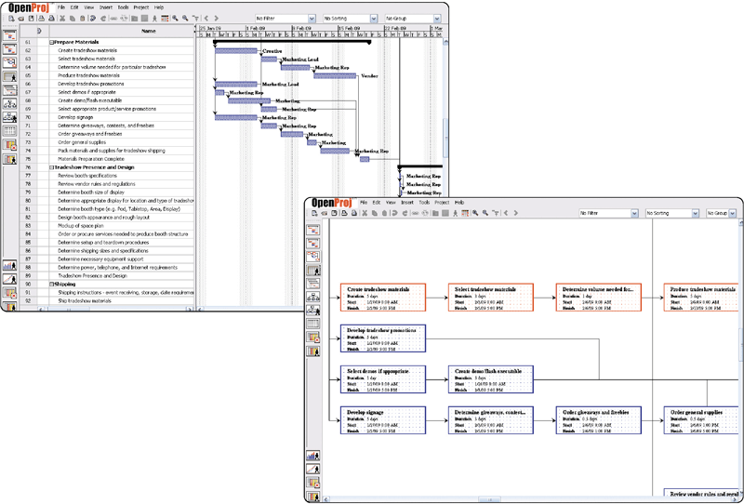
What is the System Development Cycle?
What is project management software?
Program used by project leaders to plan, schedule, and control development projects
p. 624 Fig. 12-4
Next

Slide 12
What is the System Development Cycle?
What is feasibility?
Operational feasibility
Measure of how suitable system development will be to the company
Four feasibility tests:
Schedule feasibility
Economic feasibility (also called cost/benefit feasibility)
Technical feasibility
p. 625
Next

Slide 13
What is the System Development Cycle?
What is documentation?
Collection and summarization of data and information
Includes reports, diagrams, programs, and other deliverables
Project notebook contains all documentation for single project
p. 625
Next

Slide 14

What is the System Development Cycle?
What are six data and information gathering techniques?
Review documentation
Observe
Survey
Interview
JAD sessions
Research
p. 625 - 626 Fig. 12-5
Next

Slide 15
What Initiates the System Development Cycle?
What are some reasons to create or modify an information system?
To correct problem in existing system
To improve existing system
Outside group may mandate change
Competition can lead to change
p. 626 - 627
Next

Slide 16
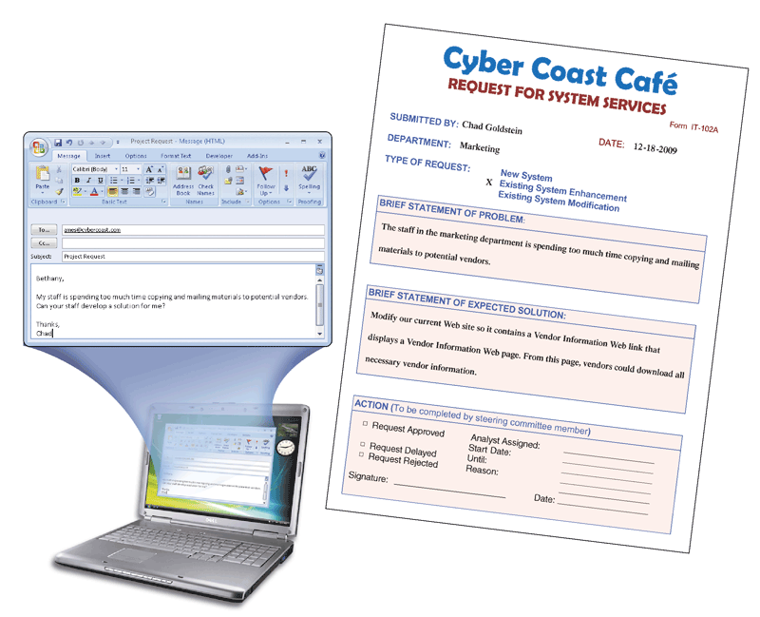
What Initiates the System Development Cycle?
What is a request for system services?
Formal request for new or modified information system
Also called project request
p. 627 Fig. 12-6
Next

Slide 17
Planning Phase
What is the planning phase?
Begins when steering committee receives project request
Steering committee—decision-making body for the company
Function of committee:
Review and approve project requests
Prioritize project requests
Allocate resources
Form project development team for each approved project
p. 629
Next

Slide 18
Analysis Phase
What is the analysis phase?
Conduct preliminary investigation, also called feasibility study
Perform detailed analysis
p. 630
Next

Slide 19
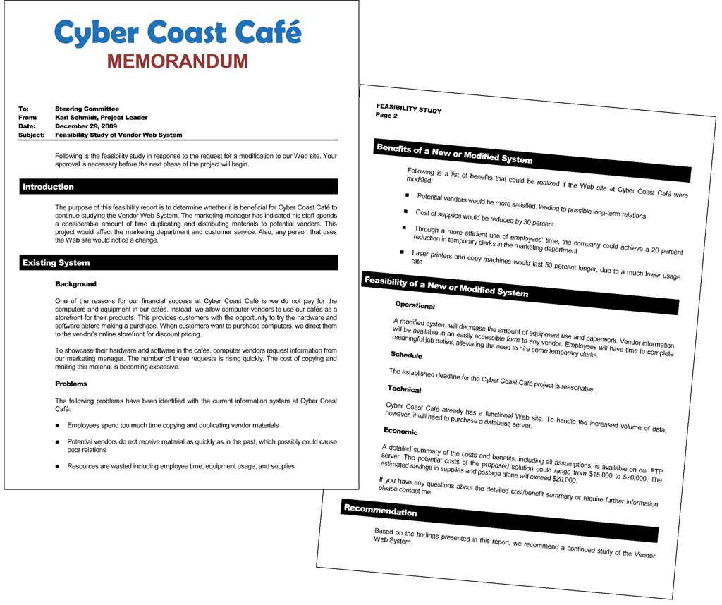
Analysis Phase
What is the preliminary investigation?
Determine exact nature of problem or improvement and whether it is worth pursuing
Findings are presented in feasibility report, also known as a feasibility study
p. 630 Fig. 12-8
Next

Slide 20
Analysis Phase
What is detailed analysis?
1. Study how current system works
2. Determine user’s wants, needs, and requirements
3. Recommend solution
Sometimes called logical design
p. 631
Next

Slide 21
Analysis Phase
What is process modeling?
Technique that describes processes that transform inputs into outputs
Also called structured analysis and design
Three tools used for process modeling
Entity-relationship diagrams
Data flow diagrams
Project dictionary
Click to view Web Link, click Chapter 12, Click Web Link from left navigation, then click Process Modeling below Chapter 12
p. 632 - 633
Next

Slide 22
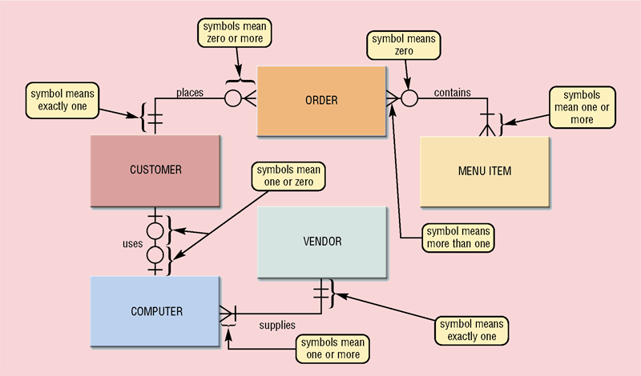
Analysis Phase
What is an entity-relationship diagram (ERD)?
Tool that graphically shows connections among entities in system
p. 632 Fig. 12-9
Next

Slide 23
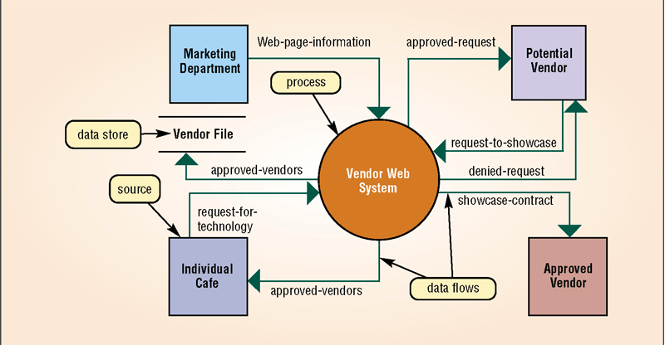
Analysis Phase
What is a data flow diagram (DFD)?
Tool that graphically shows flow of data in system
p. 632 - 633 Fig. 12-10
Next

Slide 24
Analysis Phase
What is a project dictionary?
Contains all the documentation and deliverables of project
Helps keep track of huge amount of details in system
Variety of techniques to enter items in project dictionary
Structured English
Decision tables
Decision trees
Data dictionary
p. 633 - 635
Next

Slide 25
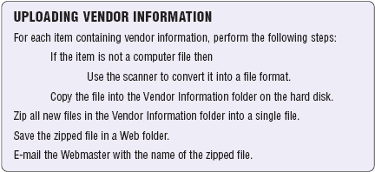
Analysis Phase
What is Structured English?
Used to explain details of process
p. 633 Fig. 12-11
Next

Slide 26
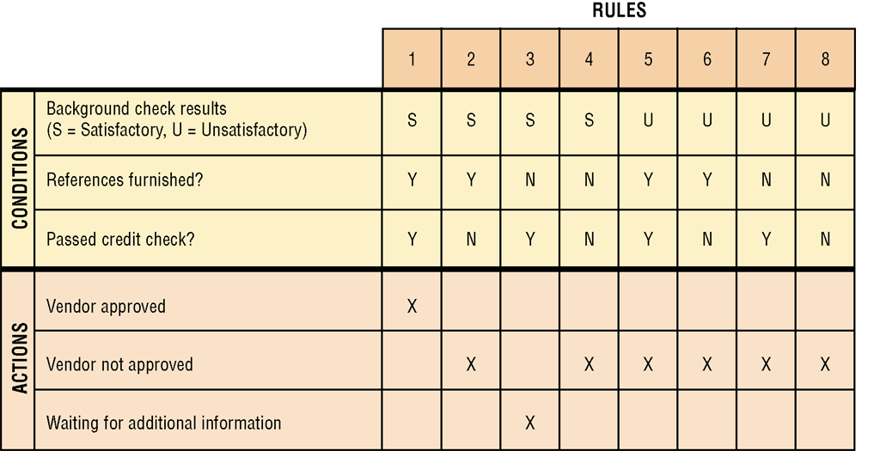
Analysis Phase
What is a decision table?
Lists variety of conditions and actions that correspond to each condition
p. 634 Fig. 12-12
Next

Slide 27
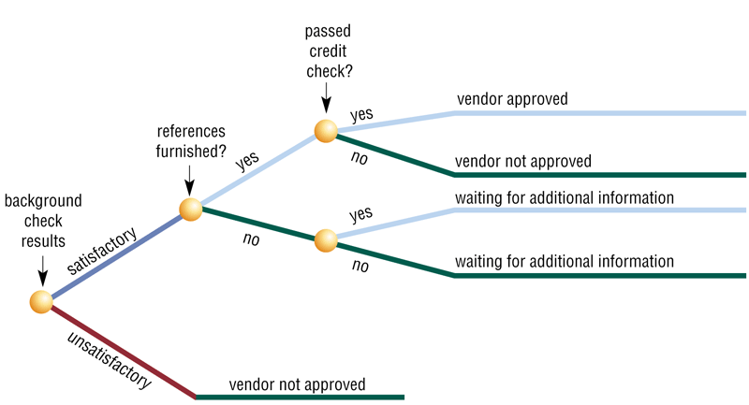
Analysis Phase
What is a decision tree?
Shows conditions and actions graphically
p. 634 Fig. 12-13
Next

Slide 28
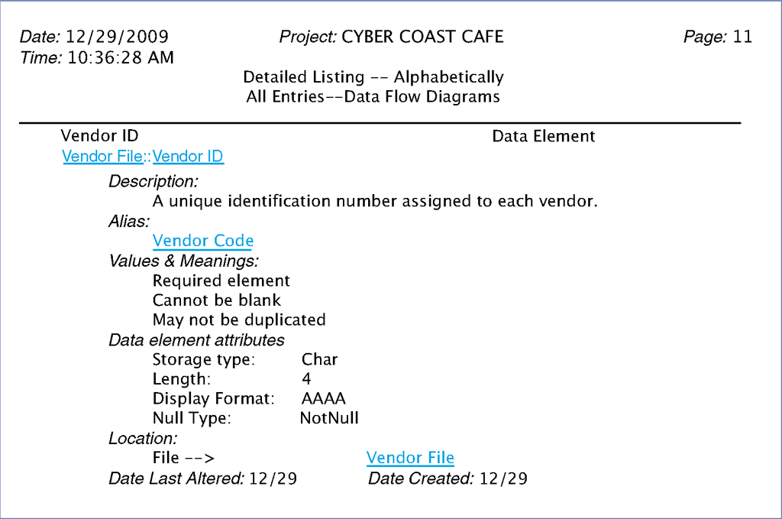
Analysis Phase
What is a data dictionary?
Stores name, description, and other details about each data item
p. 635 Fig. 12-14
Next

Slide 29
Analysis Phase
What is object modeling?
Combines data with the processes that act on data into single unit called an object
Object—an item that can contain both data and procedures that read or manipulate the data
Sometimes called object-oriented (OO) analysis and design
Uses Unified Modeling Language (UML)—graphical tool for documenting system
Click to view Web Link, click Chapter 12, Click Web Link from left navigation, then click UML below Chapter 12
p. 635
Next

Slide 30
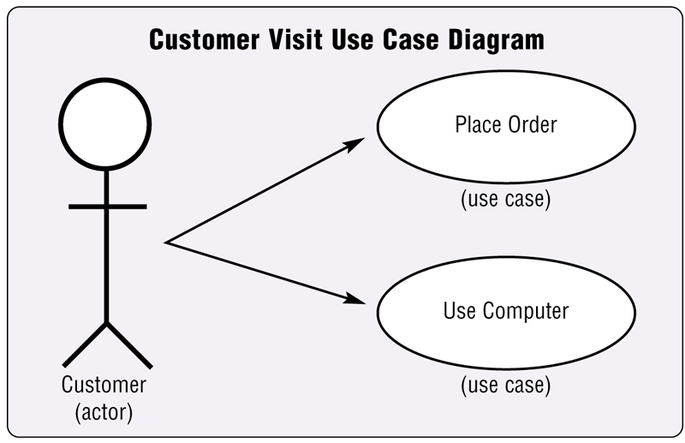
Analysis Phase
What is a use case diagram?
Graphically shows how actors interact with information system
Actor—user or other entity
Use case— function that actor can perform
p. 636 Fig. 12-15
Next

Slide 31
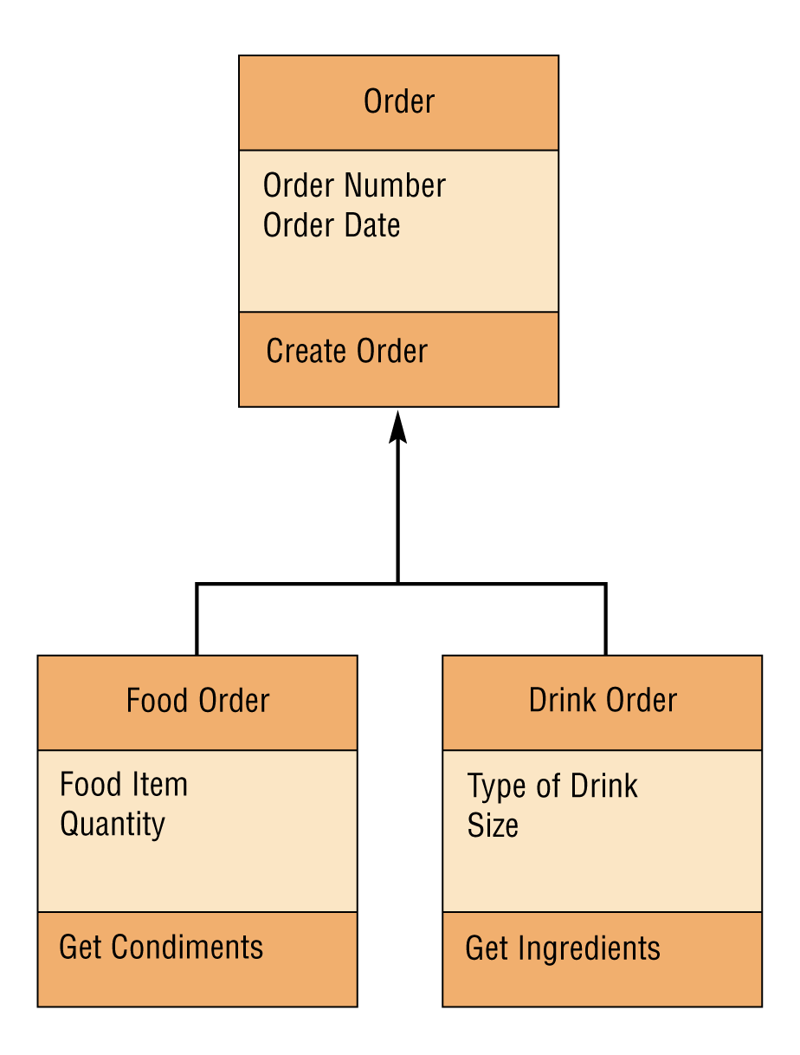
Analysis Phase
What is a class diagram?
Graphically shows classes and subclasses in system
Class is group of objects— Can have lower levels called subclasses
p. 636 Fig. 12-16
Next

Slide 32
Analysis Phase
What is the system proposal?
Assesses feasibility of each alternative solution
Presented to steering committee, which decides how system will be developed
Recommends the most feasible solution for the project
p. 636
Next

Slide 33
Analysis Phase
What are possible solutions?
Horizontal market software—meets needs of many companies
Buy packaged software—prewritten software available for purchase
Vertical market software—designed for particular industry
Write own custom software—software developed at user’s request
Outsource—have outside source develop software
p. 637
Next

Slide 34
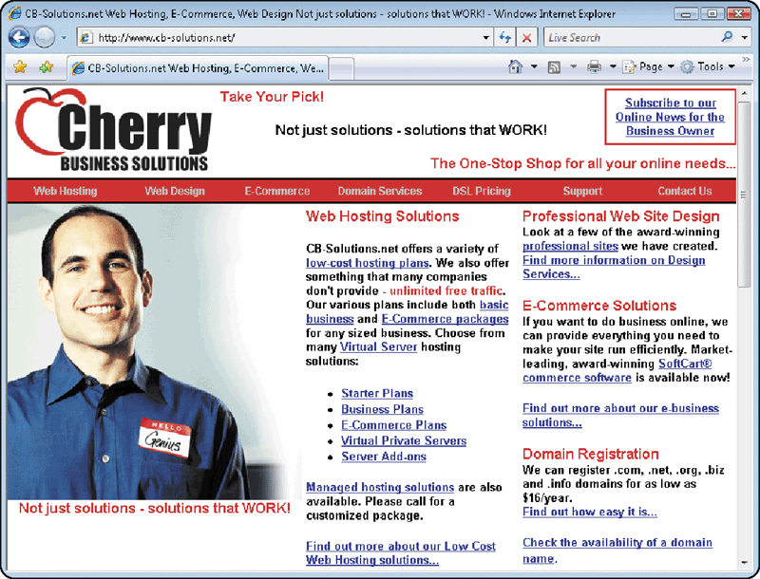
Analysis Phase
What is an example of outsourcing?
Using Internet solutions provider
Internet solutions provider provides Web hosting services
Click to view Web Link, click Chapter 12, Click Web Link from left navigation, then click Outsourcing below Chapter 12
Click to view Web Link, click Chapter 12, Click Web Link from left navigation, then click Internet Solutions Provider below Chapter 12
p. 637 Fig. 12-17
Next

Slide 35
Design Phase
What is the design phase?
Acquire hardware and software
Develop all details of new or modified information system
p. 639
Next

Slide 36

Design Phase
Video: A Tour of Lucasfilm Data Center
CLICK TO START
Next

Slide 37
Design Phase
What is needed to acquire new hardware and software?
Identify all hardware and software requirements of new or modified system
Identify technical specifications
Solicit vendor proposals
Test and evaluate vendor proposals
Make a decision
p. 639
Next

Slide 38
Design Phase
What are three basic documents used to summarize technical specifications?
Identifies product(s) you want
Vendor quotes price(s) for listed product(s)
Request for quotation (RFQ)
Request for proposal (RFP)
Vendor selects product(s) that meet(s) your requirements and then quotes price(s)
Less formal method that uses standard form to request information about product or service
Request for information (RFI)
p. 639
Next

Slide 39
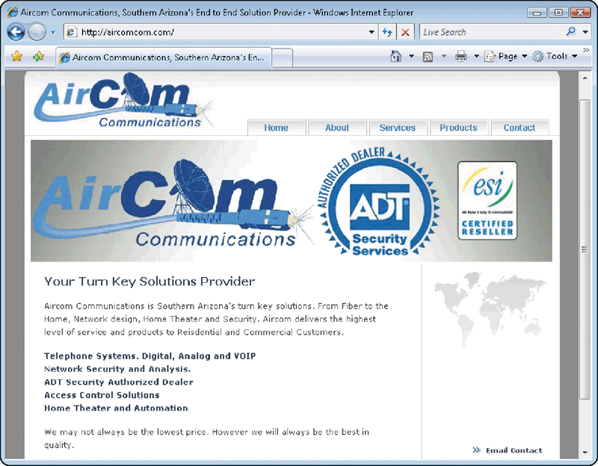
Design Phase
What is a turnkey solution?
Complete system provided by value-added reseller
Value-added reseller (VAR) purchases products from manufacturer and then resells them, offering additional services with product
Authorized VARs must meet certain manufacturer-specified requirements
Click to view Web Link, click Chapter 12, Click Web Link from left navigation, then click Value-Added Reseller below Chapter 12
p. 639 Fig. 12-18
Next

Slide 40
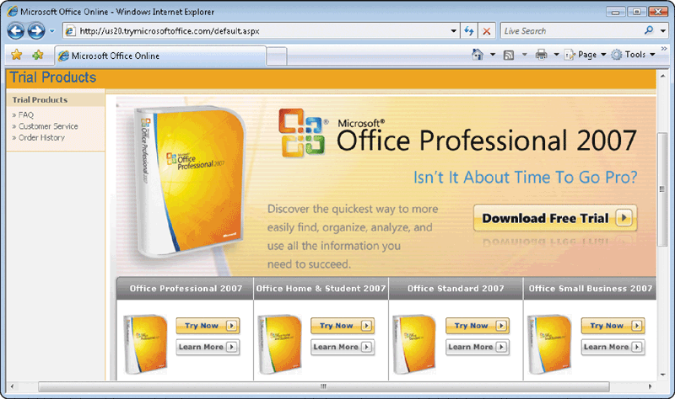
Design Phase
How do systems analysts test software products?
References from vendor
Talk to current users of product
Product demonstrations
Trial version of software
Benchmark test measures performance
Click to view Web Link, click Chapter 12, Click Web Link from left navigation, then click Benchmark Tests below Chapter 12
p. 640 Fig. 12-19
Next

Slide 41
Design Phase
What is a detailed design?
Detailed design specifications for components in proposed solution
Sometimes called physical design
Includes several activities
Database design
Input and output design
Program design
p. 641
Next

Slide 42
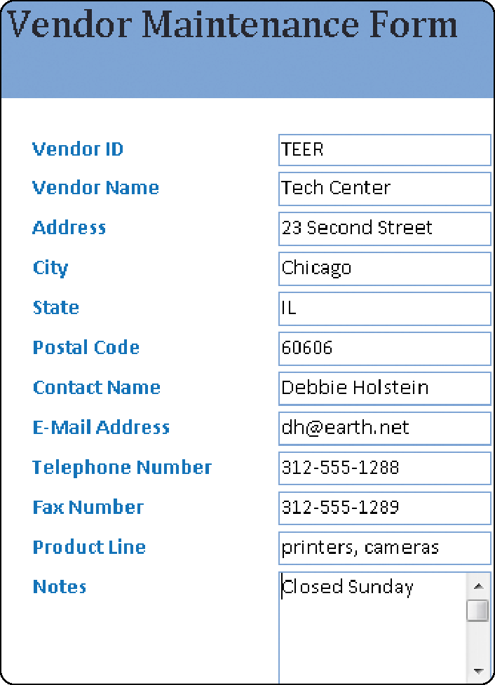
Design Phase
What is a mockup?
Sample of input or output that contains actual data
p. 641 Fig. 12-20
Next

Slide 43
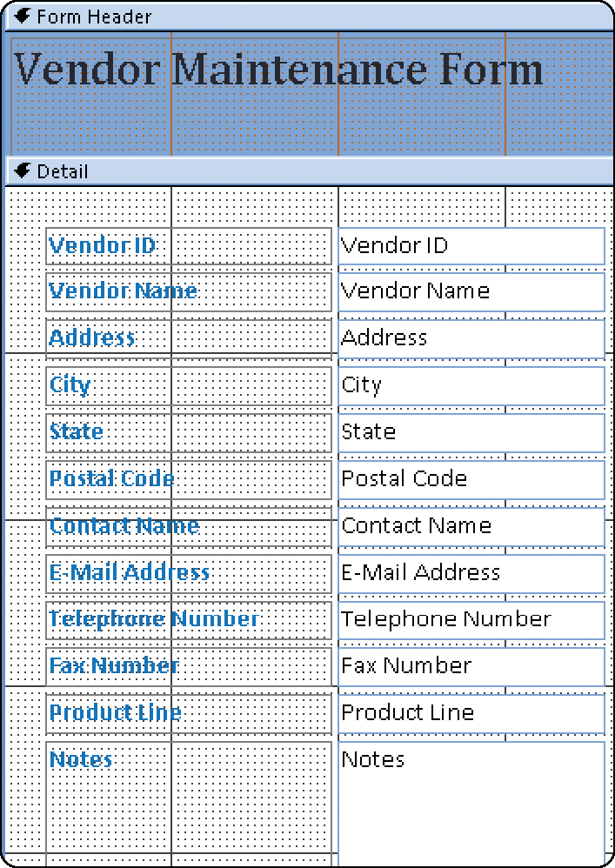
Design Phase
What is a layout chart?
Input or output that contains programming-like notations for data items
p. 641 Fig. 12-21
Next

Slide 44
Design Phase
What is a prototype?
Working model of proposed system
Beginning a prototype too early may lead to problems
p. 642
Next

Slide 45
Design Phase
What is computer-aided software engineering (CASE)?
Software tools designed to support activities of system development cycle
Project repository—Stores diagrams, specifications, descriptions, programs, and other deliverables
Graphics—Enables drawing of diagrams
Prototyping—Creates models of proposed system
Quality assurance—Analyzes deliverables for accuracy
Code generators—Create actual computer programs from design specifications
Housekeeping—Establishes user accounts and provides backup and recovery functions
Click to view Web Link, click Chapter 12, Click Web Link from left navigation, then click Case Tools below Chapter 12
p. 642 - 643
Next

Slide 46
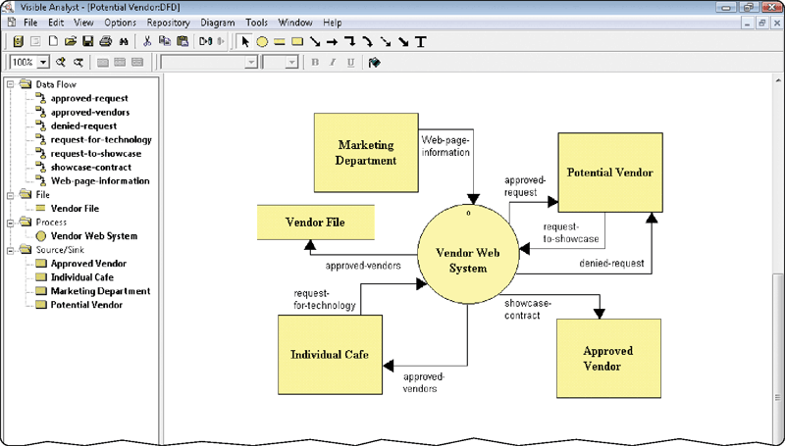
Design Phase
What is integrated computer-aided software engineering (I-CASE)?
Integrated case products
p. 642 - 643 Fig. 12-22
Next

Slide 47
Design Phase
What is an inspection?
Formal review by project team and users of any system development cycle deliverable
Used to review detailed design specifications before they are given to programming team
Identifies any errors and allows IT personnel to correct them
Used throughout entire system development cycle to review a variety of deliverables
p. 643
Next

Slide 48
Implementation Phase
What is the implementation phase?
Purpose is to construct, or build, new or modified system and then deliver it to users
Convert to new system
Train users
Install and test new system
Develop programs
p. 643
Next

Slide 49
Implementation Phase
What is the program development cycle?
Programmers write programs from specifications
Follows six steps
Analyze requirements
Document solution
Design solution
Test solution
Validate design
Implement design
p. 643
Next

Slide 50
Implementation Phase
What are the four types of tests performed by system developers?
Unit Test
Systems test
Verifies each individual program works by itself
Verifies all programs in application work together
Integration Test
Acceptance Test
Verifies application works with other applications
Verifies the new system works with actual data
p. 644
Next

Slide 51

Implementation Phase
What is training?
Showing users exactly how they will use new hardware and software in system
p. 644 Fig. 12-23
Next

Slide 52
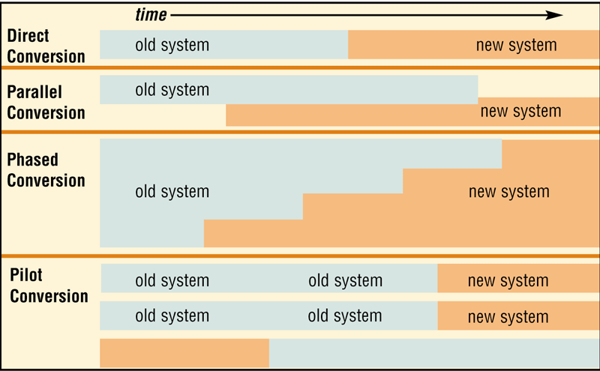
Implementation Phase
What are conversion strategies?
Used to change from old system to new system
p. 644 - 645 Fig. 12-24
Next

Slide 53
Operation, Support, and Security Phase
Conduct post-implementation system review—meeting to find out if information system is performing according to expectations
Perform Maintenance Activities
What is the operation, support, and security phase?
Provides ongoing assistance after system is implemented
Monitor System Performance
Assess System Security
p. 646
Next

Slide 54
Operation, Support, and Security Phase
What is a computer security plan?
Summarizes in writing all of the safeguards that are in place to protect a company’s information assets
Identify all information
assets of an
organization
Identify all security risks that may cause an information asset loss
For each risk, identify the safeguards that exist to detect, prevent, and recover from a loss
Click to view Web Link, click Chapter 12, Click Web Link from left navigation, then click Chief Security Officer below Chapter 12
Click to view Web Link, click Chapter 12, Click Web Link from left navigation, then click ICSA below Chapter 12
p. 646
Next

Slide 55
Summary of Information System Development
Phases in the system development cycle
Activities that occur during the entire system development cycle
Guidelines for system development
Chapter 12 Complete

